Slide 1

Analysis Of Brief

Slide 2
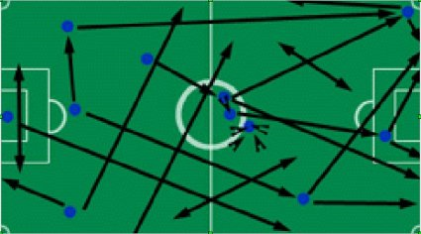
Analysis Of Brief
What is it?
In an analysis, one breaks up the subject into different parts and studies them in order to gain a better understanding of the subject as a whole.
For example, you may have seen after a sports match on television a team of people go through the different aspects of the match. Lets say Ireland, for instance, may have won the match but when we examine how each athlete played, tactics used and attitudes on the pitch we may come to the conclusion that they played poorly as a whole. This is analysis.

Slide 3



Your Brief
How can I analyse my brief?
Your brief will include a number of key words and key phrases. These key words/phrases may be essentials that must be incorporated into your projects or they may be clues as to what your design should do.
Your brief will more than likely have words you may not understand! It is important to research and define each of these words.
Use a dictionary, the internet or speak to people as a means to define these key words.

Slide 4
Example: Highlight the key words/phrases in the following
Lets take a past Leaving Certificate Design Brief:
There are many examples of machines which aid training in various sporting activities.
Design a simple table tennis serving machine, to the general specifications outlined below, which will eject a ball periodically to a practicing player.
The machine should:
  Be table mounted;
  Have a ball container with the capacity for at least 10 practice balls;
  Incorporate a mechanism to eject a ball periodically;
  Include an electronic indicator to signal when the feed container is empty.
Presentation of the completed machine should ensure that:
  All main operating features are clearly visible without dismantling.
  The longest dimension of the model does not exceed 300mm (NOT INCLUDING THE BALL CONTAINER).
Electric power does not exceed 9 volts.

Slide 5
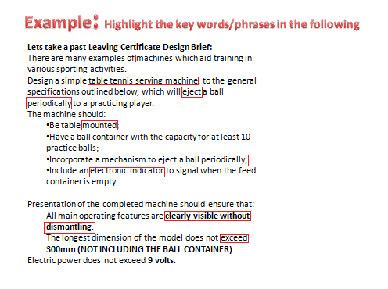
Highlighted Words and terms:
1.Machines
2.Serving
3. Eject
4. Periodically
5. Mounted
6. Mechanism
7. Electronic Indicator
8. Visible
9. Exceed

Slide 6
Define the Key Words/Terms
Machine- A mechanical apparatus with interrelated mechanisms with separate functions
Serving- to aid the player/distribute the ball to the player
Eject- to drive, force out or expel (the ball)
Periodically- recurring at intervals of time.
Mounted- to be put into position for use.
Mechanism- an assembly of moving parts performing a complete functional motion.
Electronic Indicator- a pointing or directing device powered by electronics.
Visible – can be seen.
Exceed- to go beyond limits or boundaries (constraints)

Slide 7
Finally
After gaining an understanding of all the key words and terms used In the brief, write it out in your own words. This is to portray that you have full understanding of what you are required to do.
Example:
“I am to design and make a machine that will serve table tennis balls to a practicing player. My design should hold 10 balls, it should have a way of being held on a table, it should distribute the balls at regular time intervals. When the ball container is empty there should be an electronic signal that will let the user know.
It can’t be bigger than 300mm and all the parts should be visible to the examiner.”

